Slide 1

Azure Logic Apps
Vikram Chaudhary
www.dotnetforall.com
- @dotnetforall

Slide 2
Free Developer Benefit Azure Account
Anyone can create the azure account
Valid for 12 Months
Rs 1600 Credited every month.

Slide 3
Logic Apps
Why
What
How

Slide 4
Why do we need Logic Apps?
Multiple LOB exits in an organizations
All systems need to Perform CRUD operations
Data is player
Extraction transformation and Load (ETL)
Orchestrate business process and System integration
Easy to use design tools
Connect APIs easily
Get started quickly from templates
Real integration horsepower

Slide 5

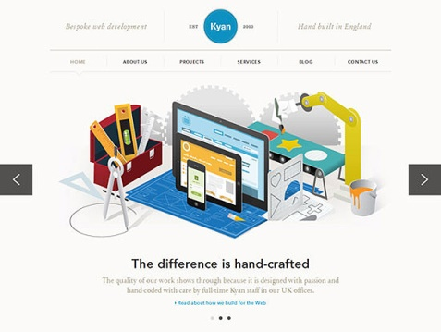
ETL Example
Checkout Order
Creates new Customer
CRM
Sales Force, Dynamics
Creates new Order
Sales System
SAP

Slide 6
What is Logic App
Part of Microsoft Azure which contain lots of similar services
Need to at least know the basics of these services.
Successor of Biztalk orchestration.
iPaas
Exits to make Orchestrating Business processes and System integration easier and a visual process.
As product of Azure, it boasts high scalability and reliability.
Various connectors are available which can act as triggers and actions in over all orchestration.

Slide 7
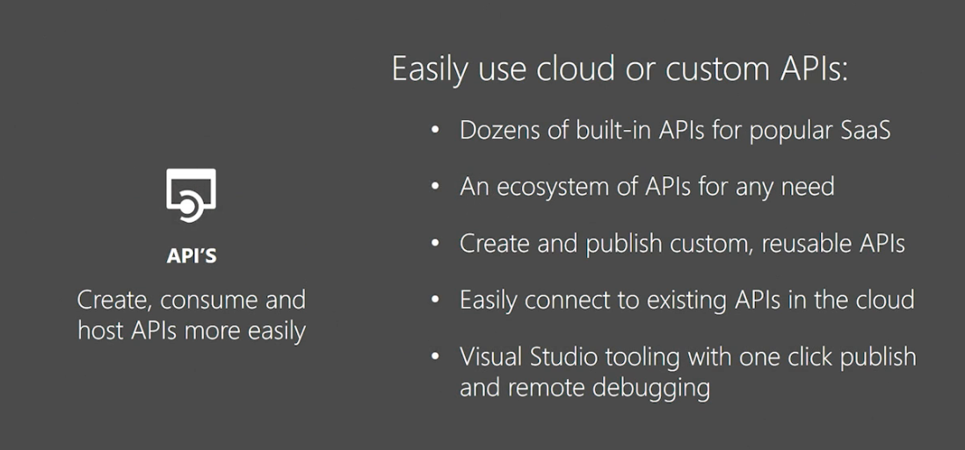
API

Slide 8
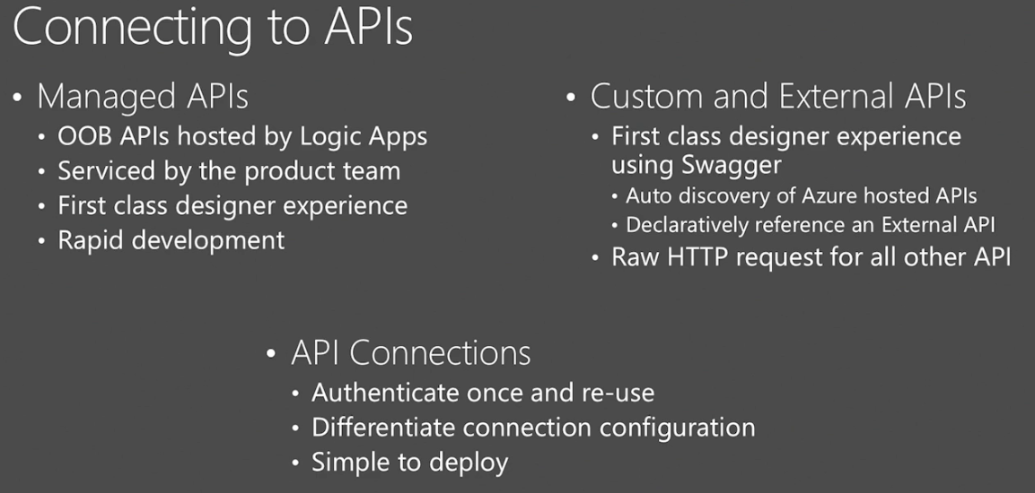
Connectors

Slide 9
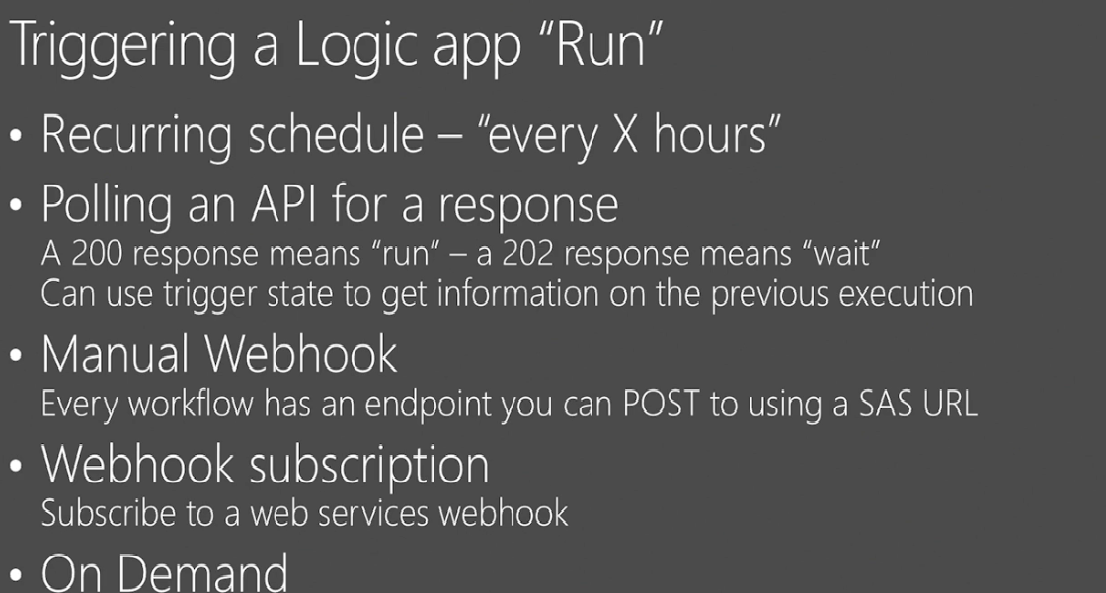
Triggers

Slide 10
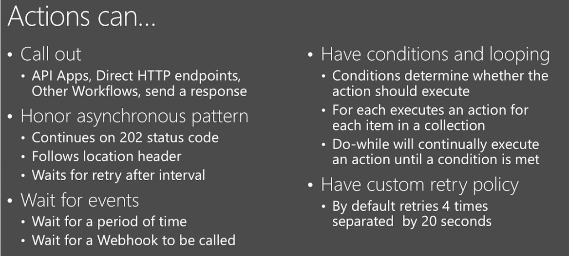
Actions

Slide 11
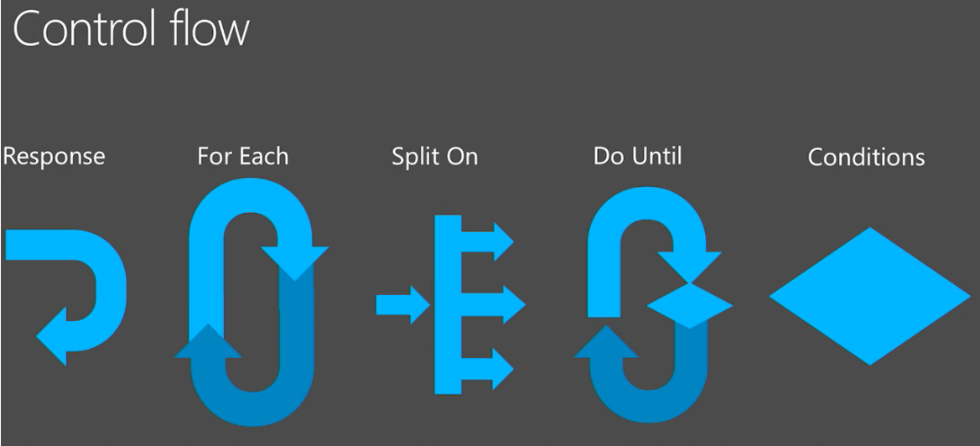
Work Flows

Slide 12
Pricing
ACTIONS EXECUTED / MONTH | PRICE PER ACTION EXECUTION
First 250K actions | ₹0.0481 / action
251K-1M actions | ₹0.024 / action
1M-50M actions | ₹0.00901 / action
50M-100M actions | ₹0.00541 / action
100M+ actions | ₹0.003245 / action

Slide 13
DEMO TIME

Slide 14
References
http://blog.falafel.com/azure_logic_apps_orchestrating_business/
https://docs.microsoft.com/en-us/rest/api/logic/definition-language
https://msdn.microsoft.com/en-us/library/azure/dn948512.aspx
https://channel9.msdn.com/Events/Build/2016/P462

